Slide 1

Epilepsy Prediction
P Madhav
(Summer Internship)
Project Owner: Sumera N Hasham Project Mentor: Nishit Mittal Project Buddy: Subhrangshu Bit

Slide 2
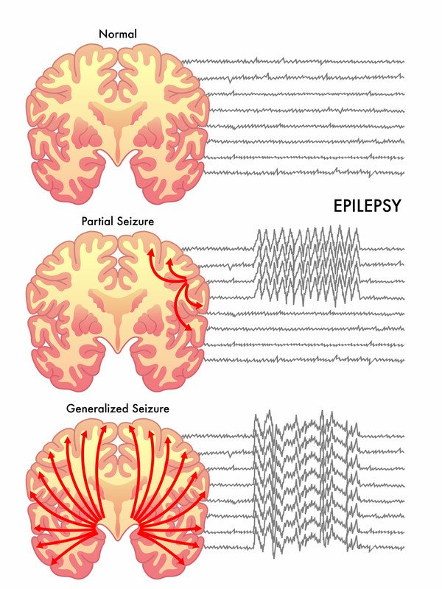

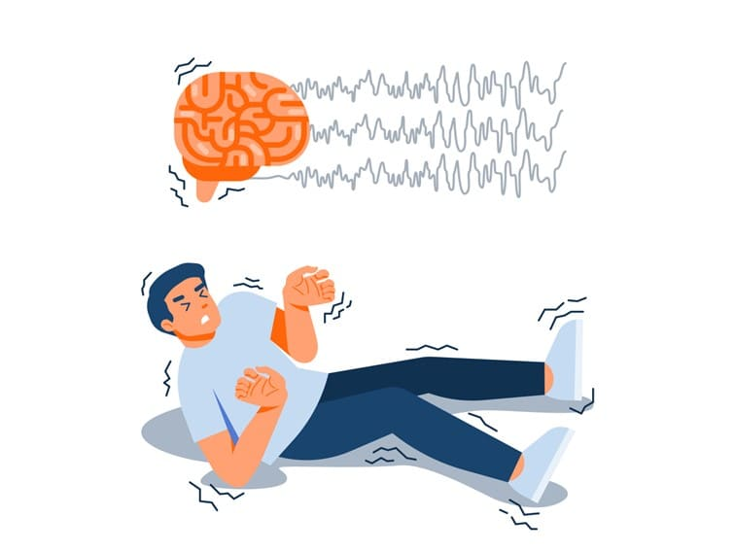

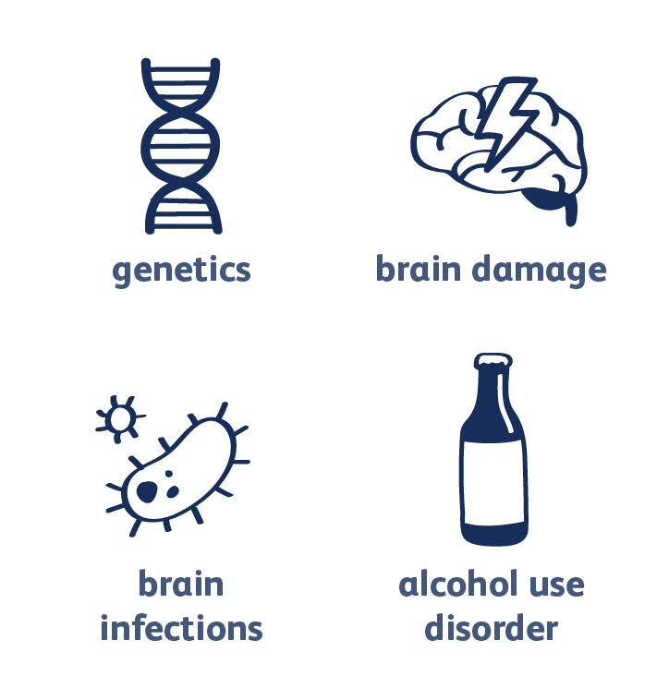
Problem statement
Types of seizures
Epilepsy is one of the most common neurological disorder, which occur 1% of the world’s population and it is characterized by the occurrence of spontaneous “Seizures”. These seizures are caused by electrical discharge of brain cells.
According to the World Health Organization (WHO), approximately 50 million people have epilepsy globally.
Objective:
Understand the data science model developed in TJay tool.
Build and support development of an overall architecture of the solution.
Monitor and brainstorm deployment of the tool
70 %
Patients
Causes for seizures
30%
Can be prevented by anticonvulsant drugs.
Medications won’t be effective and may have unwanted side effects.

Slide 3
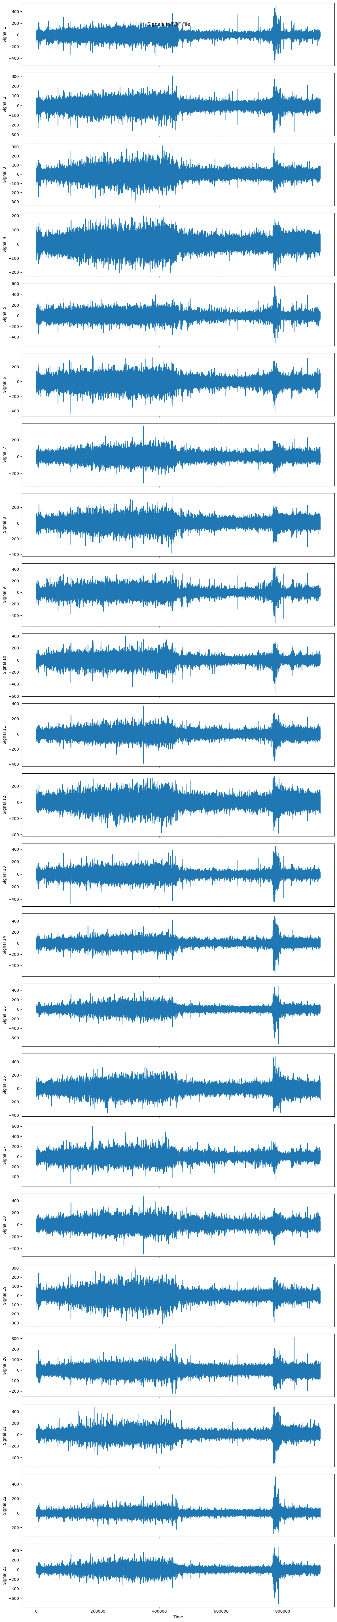

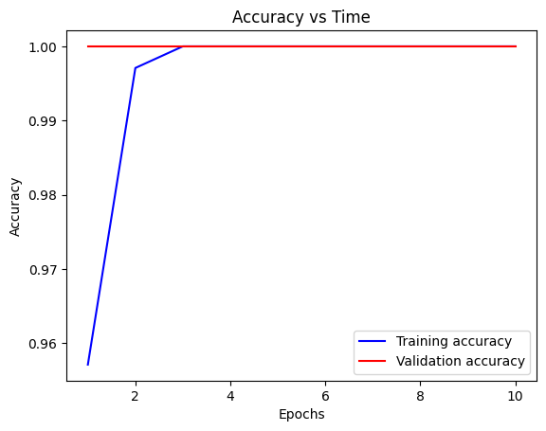
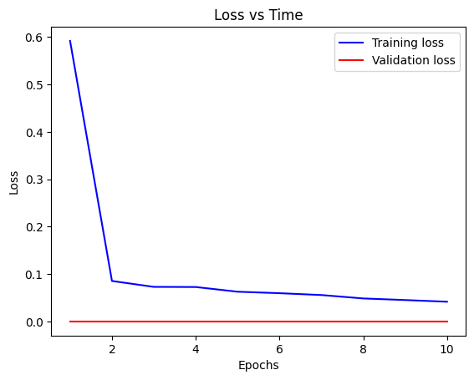
Completed Activities
CHB-MIT Scalp EEG Database
by Children’s Hospital Boston (CHB) and the Massachusetts Institute of Technology (MIT)
22 subjects (5 males, ages 3–22; and 17 females, ages 1.5–19)
Sampling rate: 256 samples per second with 16-bit resolution
Onsets and ends of 182 seizures are annotated.
Each EDF file contain 23 EEG signals (24 or 26 in a few cases)
Dataset: Considered data of 5 patients and preprocessed then into frequency domain using Fourier Transform methods. Data of 12.08GB was used. Data Split: 66.66% Train, 33.33% Test.
23 signals of an EDF file, each of 3600s duration
Results
Epochs: 10
Train loss: 0.0417
Train accuracy: 1.0000
Validation loss: 0.0000e+00
Validation accuracy: 1.0000

Slide 4
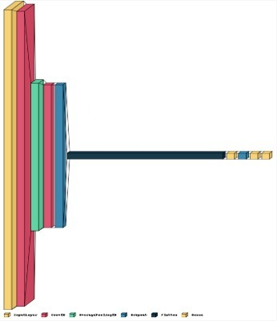
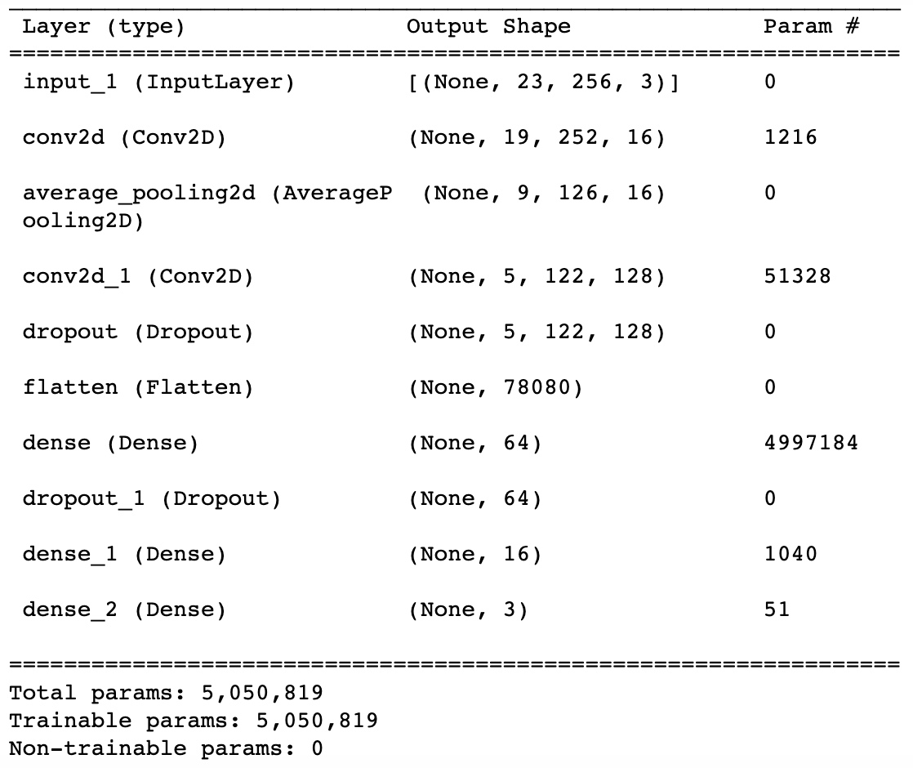
CNN Architecture
Input layer
Convolutional layer
Average pooling layer
Dropout layer
Dense & output layers
Flatten layer
Dropout layer
Convolutional layer

Slide 5
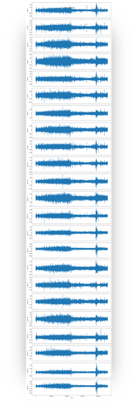
Current Improvements
Comparison with other datasets
Undersampling
Preprocessing
Autoencoder
Machine Learning Algorithms
Ensembled model

Slide 6
Comparison with other datasets
Siena Scalp EEG Database
by Unit of Neurology and Neurophysiology of the University of Siena, Italy.
14 subjects 9 males (ages 25-71) and 5 females (ages 20-58)
Sampling rate: 512 Hz
47 seizures on about 128 recording hours
Each EDF file contain 34 EEG signals
Source: https://physionet.org/content/siena-scalp-eeg/1.0.0/

Slide 7
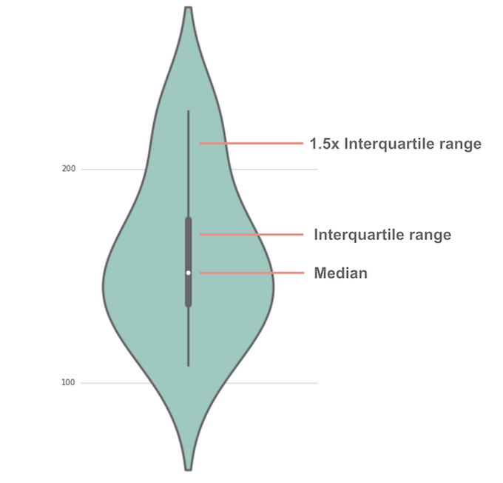
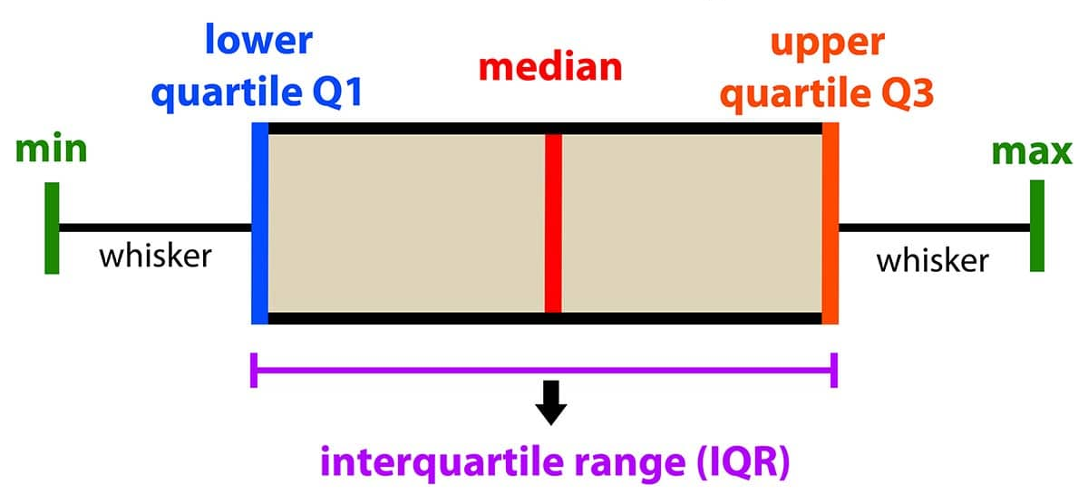
Comparison with other datasets
Box plot
Violin plot
Types of plots used, for reference.

Slide 8
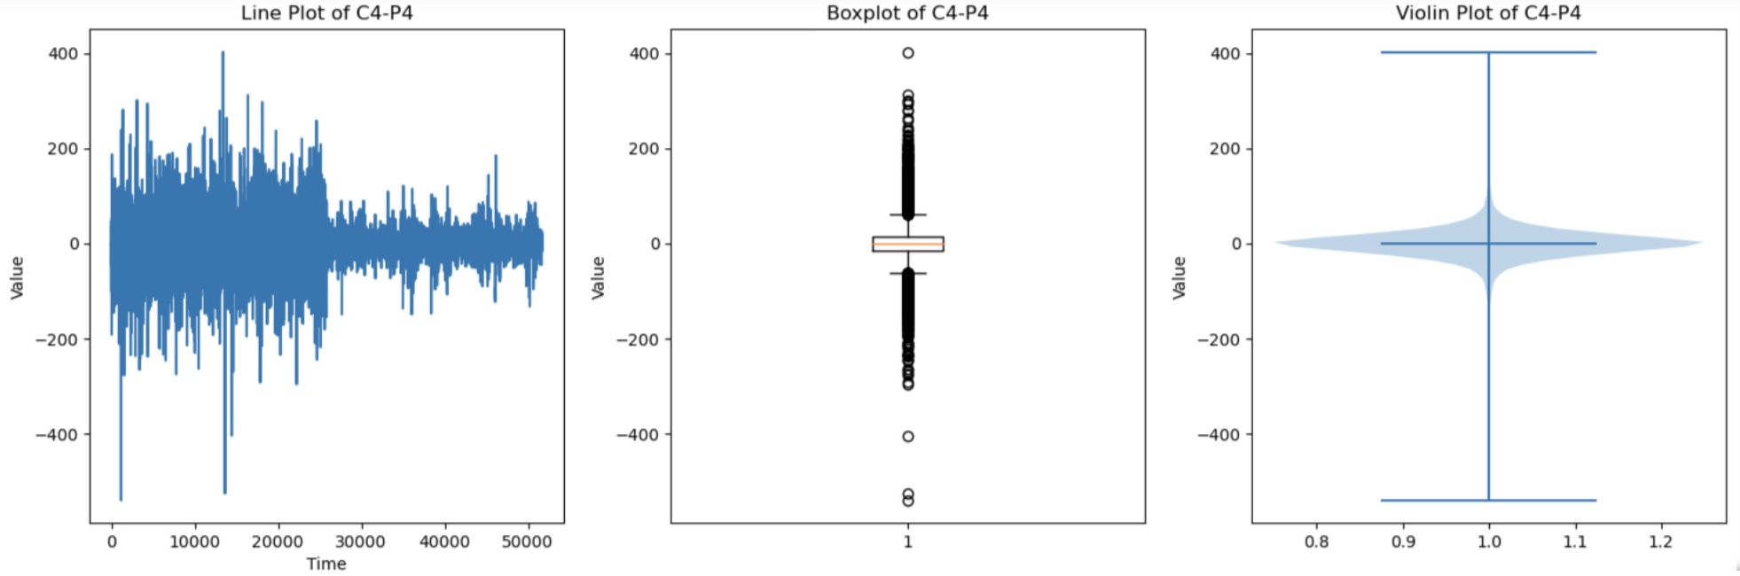
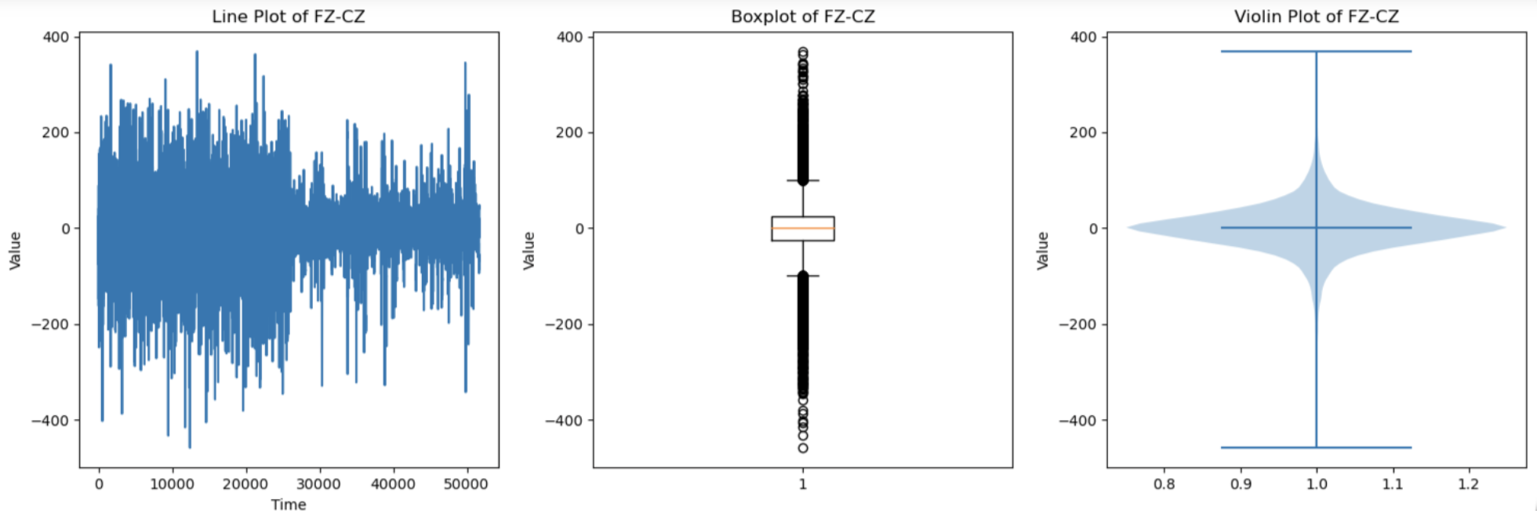
Comparison with other datasets
Siena Scalp EEG

Slide 9
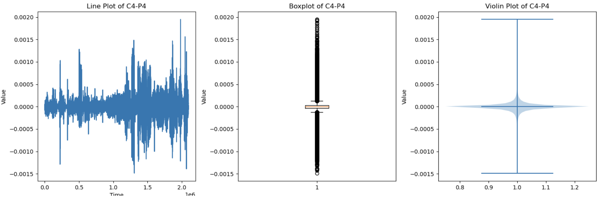
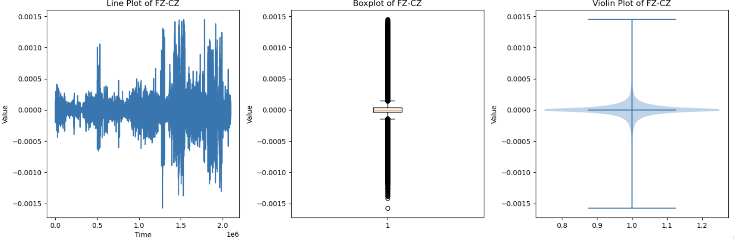
Comparison with other datasets
CHB-MIT EEG

Slide 10
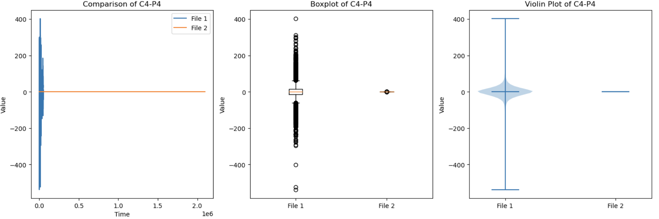
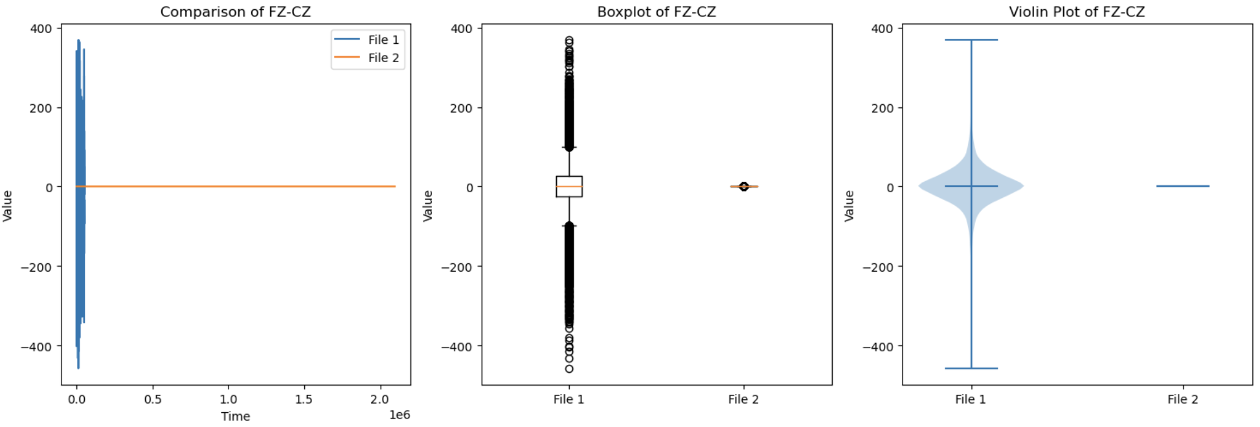
Comparison with other datasets
Siena Scalp EEG vs CHB-MIT EEG

Slide 11


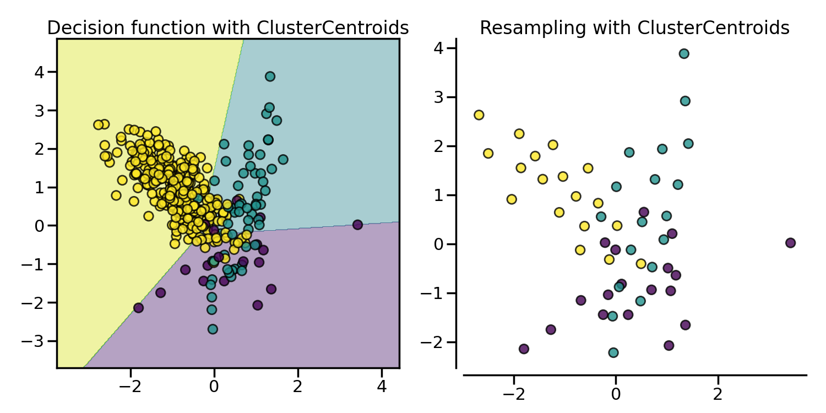
Undersampling (Preprocessing)
Data imbalance: “Rare event problem”. Model is getting heavily biased towards non-seizure prediction, resulting in high accuracies.
Data imbalance
Non-seizure
Seizure
Python Library: imblearn.under_sampling
ClusterCentroids offers an efficient way to represent the data cluster with a reduced number of samples.
There were much varied results in multiple experiments using random sampling. So I’ve used k-means cluster based under sampling method.
For 3 patients, there were 2,97,600 datapoints initially for preictal class, after under sampling the final number of datapoints of preictal class are reduced to equalize pre ictal and ictal class datapoints, i.e. 25,607.

Slide 12


PREPROCESSED CHB-MIT SCALP EEG DATABASE
Dataset - CHB-MIT | CHB-MIT
Signals format | .edf
Preprocessed format | .csv
No. of patients | 24
Data of each patient extracted | 4096 seconds (68 mins)
Total datapoints in final csv | 2,097,150
Channels (Features) | 23 (Scalp electrodes signals)
Preprocessed files size | 626.22 MB (reduced from 45GB)
Python Library used | mne (especially for extracting human neurophysiological data)
Published on | 24-05-2022
Published Journal | IJHS (International Journal of Health Sciences)
Source | https://ieee-dataport.org/open-access/preprocessed-chb-mit-scalp-eeg-database
Research Paper: Deepa, B., & Ramesh, K. (2022). Epileptic seizure detection using deep learning through min max scaler normalization. International Journal of Health Sciences, 6(S1), 10981–10996.
https://doi.org/10.53730/ijhs.v6nS1.7801

Slide 13
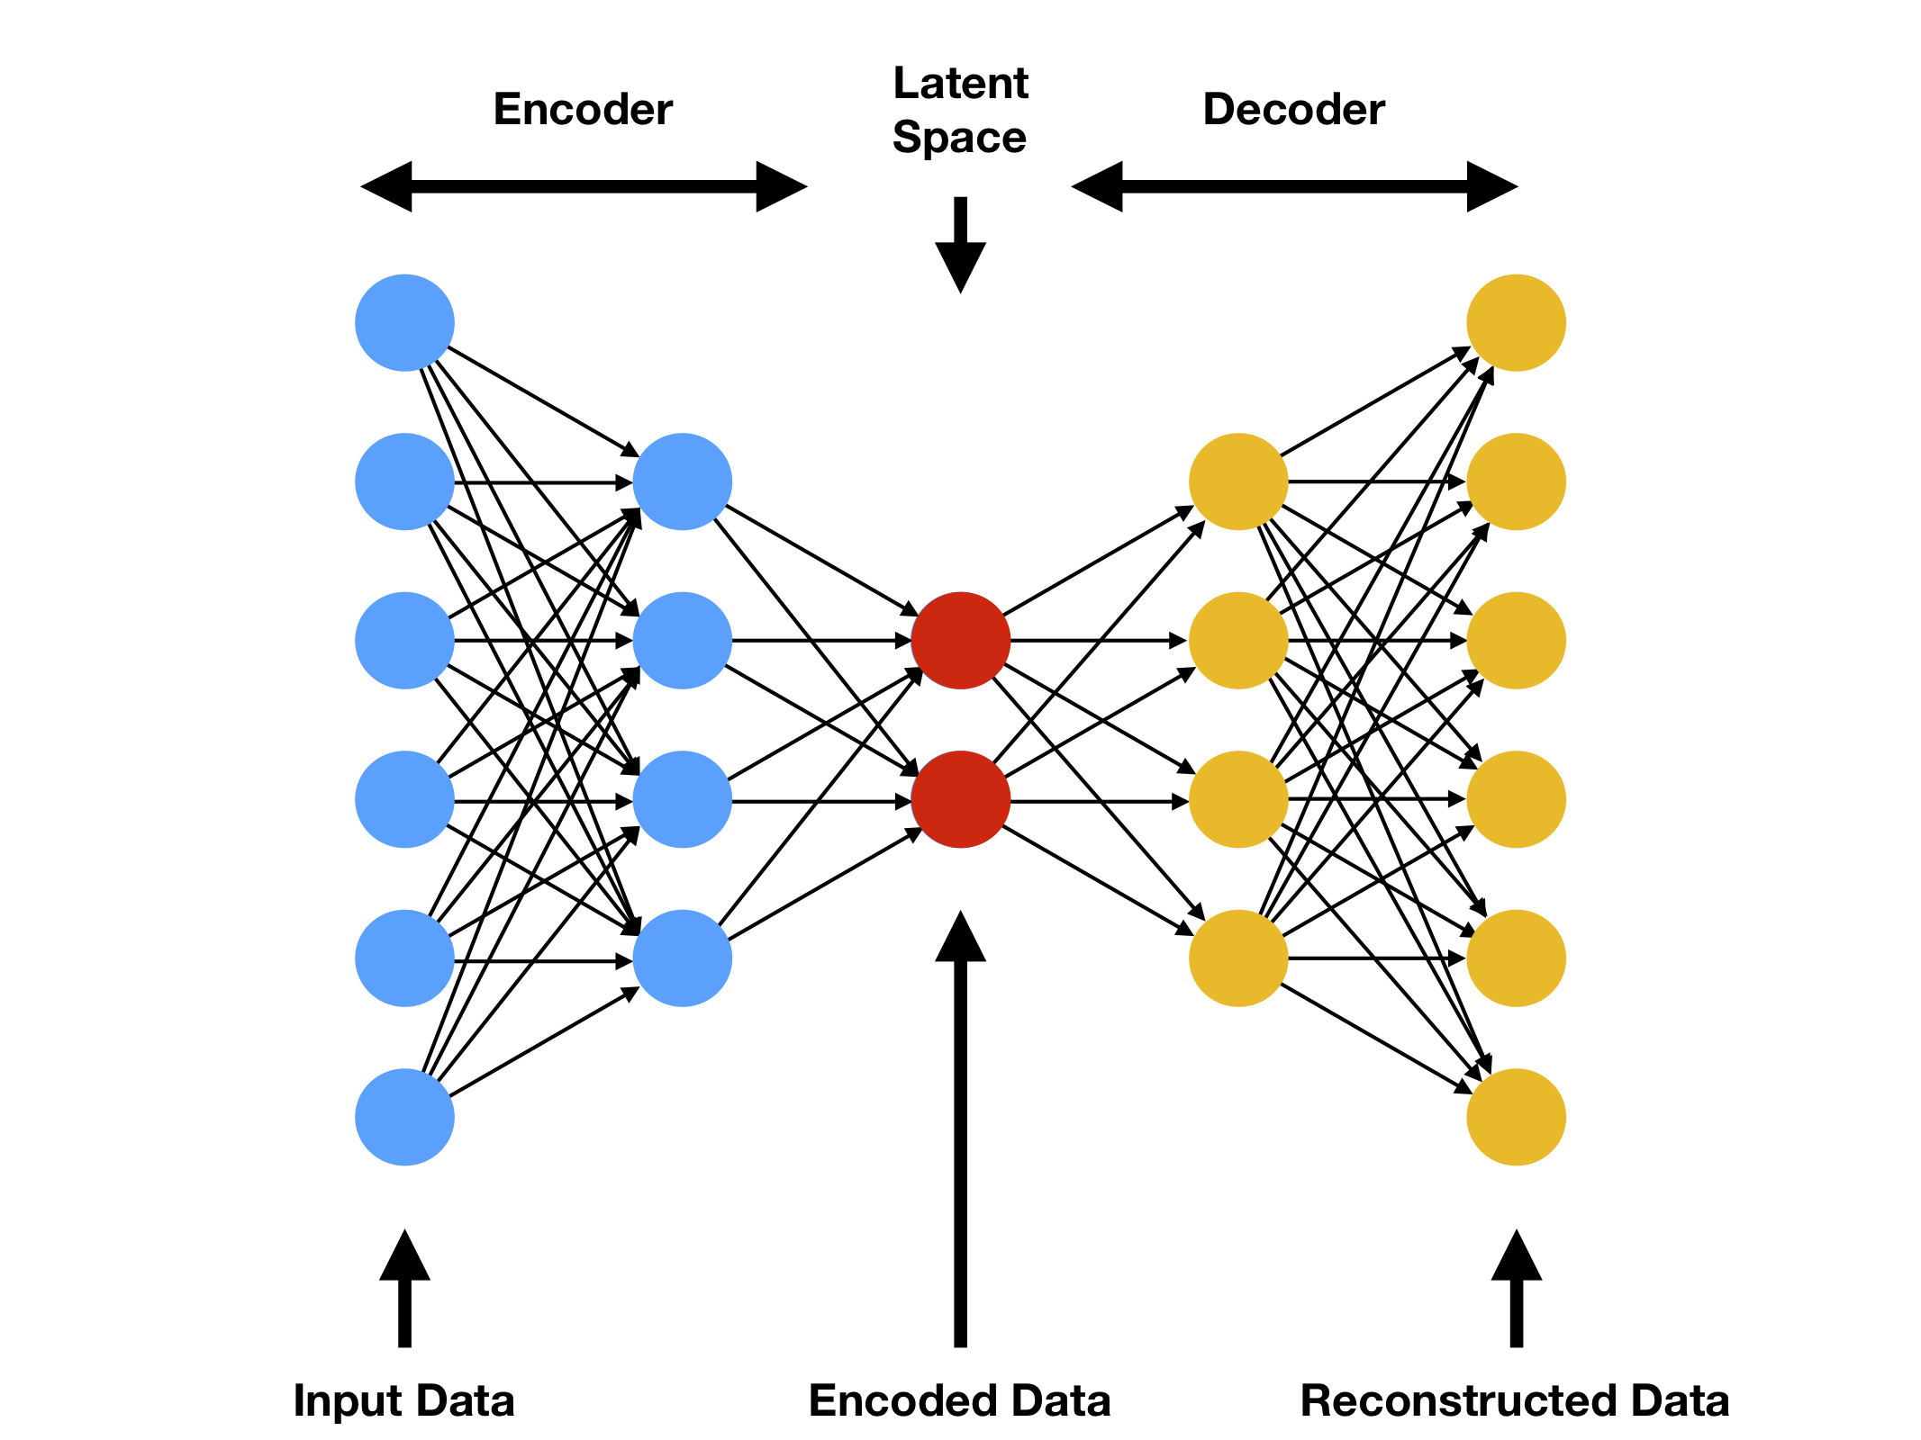
Auto Encoder (Feature Extraction)
Autoencoders are neural networks trained to reconstruct their original input.
An Autoencoder is a form of feature extraction algorithm. The output of an autoencoder is the middle layer, the representation for each data point.
We can use the features generated by an AE in any other algorithm, for example for classification.
We can use a simple dense layers autoencoder to build a rare event classifier.
Preprocessing: Data Standardization (transformed to Gaussian: Mean 0 and SD 1)
Using sklearn.preprocessing library

Slide 14
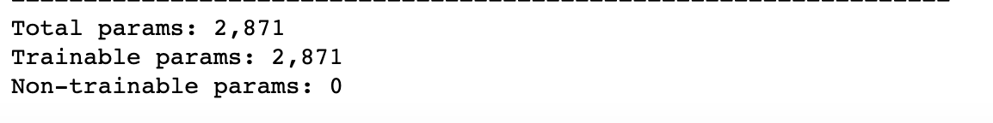
Auto Encoder – 1 (Feature Extraction)
Batch size: 128
Epochs: 20
Optimizer: Adam
AutoEncoder architecture:
Input Layer
Layer | Shape (Features) | Parameters
Input | 23 | 0
Dense | 32 | 768
Dense | 16 | 528
Dense | 16 | 272
Dense | 32 | 544
Dense (output) | 23 | 759
Encoder
Decoder
Output Layer

Slide 15
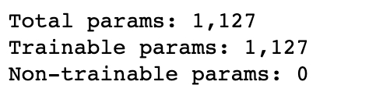
Auto Encoder – 2 (Feature Extraction)
Batch size: 128
Epochs: 20
Optimizer: Adam
AutoEncoder architecture:
Input Layer
Layer | Shape (Features) | Parameters
Input | 23 | 0
Dense | 16 | 384
Dense | 8 | 136
Dense | 8 | 72
Dense | 16 | 144
Dense (output) | 23 | 391
Encoder
Decoder
Output Layer

Slide 16
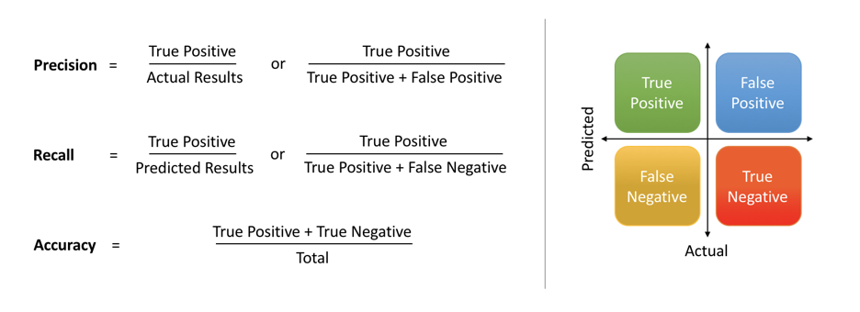
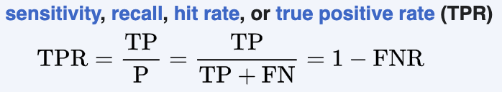
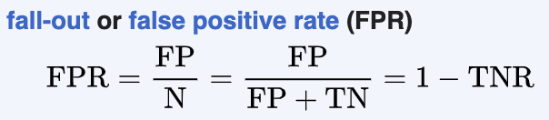
Metrics
Used sklearn.metrics library
Accuracy: Ratio between the number of correct predictions to the total number of predictions.
Precision: ratio between the number of Positive samples correctly classified to the total number of samples classified as Positive (either correctly or incorrectly).
Recall: ratio between the number of Positive samples correctly classified as Positive to the total number of Positive samples.
F1 Score: Harmonic mean of Precision and Recall.
Loss: MSE (Mean Squared Error)
Macro-average: all classes equally contribute to the final averaged metric.
Weighted-average: each class's contribution to the average is weighted by its size.
ROC Curve: TPR vs FPR curve
In our case, since the preprocessed data is not imbalanced, the results will be same for macro-average and weighted-average.

Slide 17
Ensembled model - 1
Model | Training Time (s)
Random Forest | 17.37
SVM | 406.21
Logistic Regression | 0.23
XGBoost | 5.67
Algorithm parameters | Details
ML Algorithms used | 'Random Forest', 'SVM', 'Logistic Regression', 'XGBoost'
Total number of data points | 41,944
Number of data points of each class | 20,972
Number of features | 23
Train – Test split | 80% - 20%
Ensemble method used | Max voting
Model | Testing Time (s)
Random Forest | 0.70
SVM | 35.93
Logistic Regression | 0.01
XGBoost | 0.05

Slide 18
Ensembled model - 2
Model | Training Time (s)
Random Forest | 238.07
Decision Tree | 20.82
Logistic Regression | 0.23
XGBoost | 49.45
Algorithm parameters | Details
ML Algorithms used | 'Random Forest', 'Decision Tree’, 'Logistic Regression', 'XGBoost'
Total number of data points | 4,19,430
Number of data points of each class | 2,09,715
Number of features | 23
Train – Test split | 80% - 20%
Ensemble method used | Soft/weighted voting
Model | Testing Time (s)
Random Forest | 8.96
Decision Tree | 0.11
Logistic Regression | 0.01
XGBoost | 0.28

Slide 19
RESULTS
Notes:
Explain metrics used

Slide 20
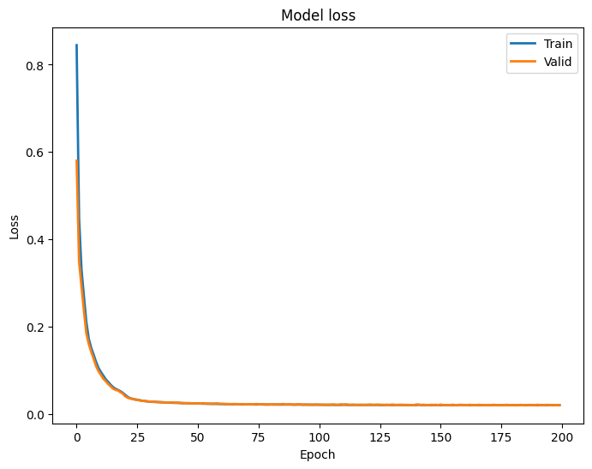
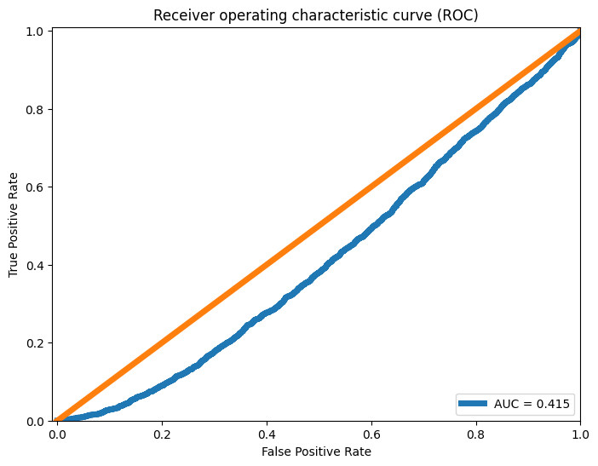
Auto Encoder (Feature Extraction)
Based on preprocessed data of 3 patients
Accuracy: around 81%
Results:
Random Classifier

Slide 21
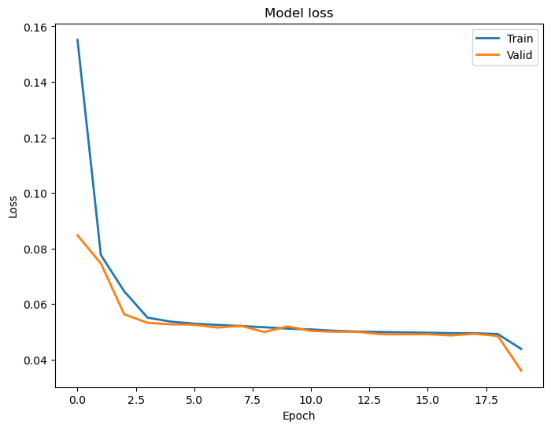
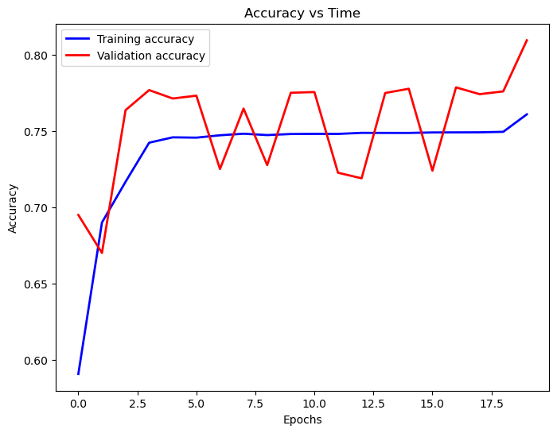
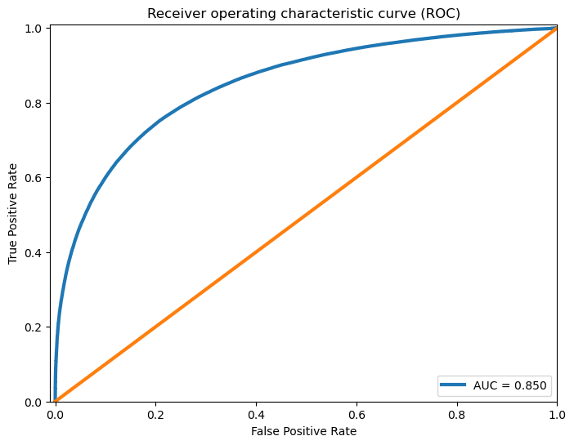
Auto Encoder - 1
Results:
Dimensionality reduction from 23 to 16
Based on preprocessed data of all patients (IEEE Preprocessed dataset)

Slide 22
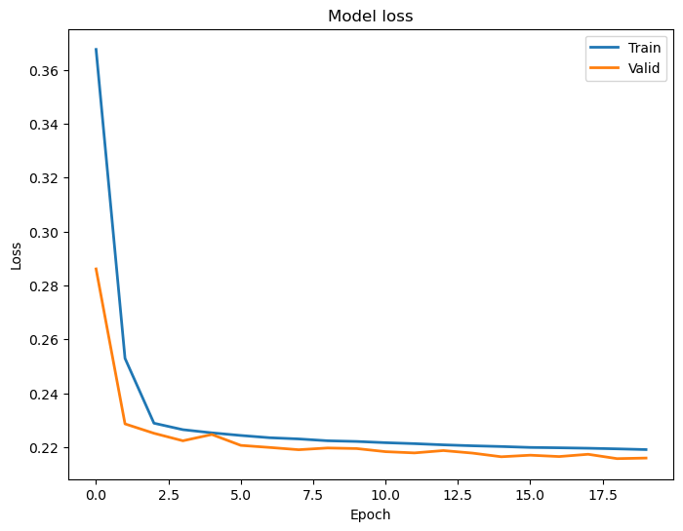
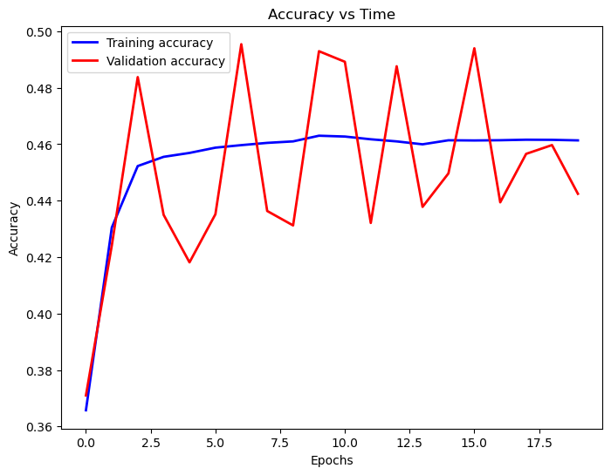
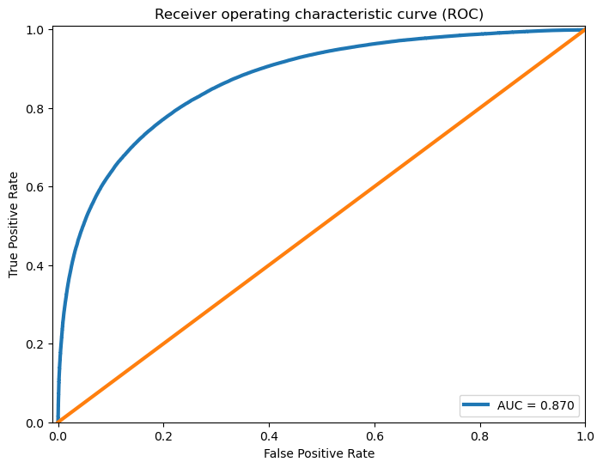
Auto Encoder - 2
Results:
Dimensionality reduction from 23 to 8
Based on preprocessed data of all patients (IEEE Preprocessed dataset)
More fluctuations and less accuracy than previous model.
Too much dimensional reduction doesn’t help.

Slide 23
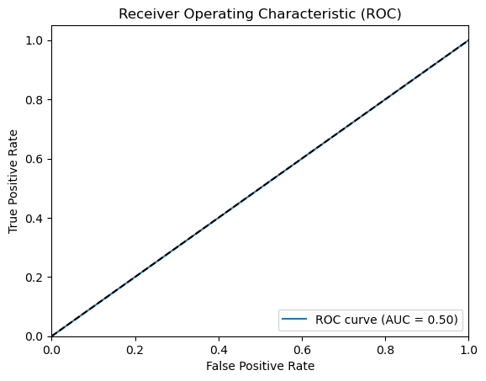
ML Algorithms
Logistic Regression
CLASSIFICATION REPORT
 | Non-ictal | Ictal | Macro/weighted avg
Accuracy | 49.79%
Precision | 0.50 | 0.00 | 0.25
Recall | 1.00 | 0.00 | 0.50
F1-Score | 0.66 | 0.00 | 0.33
Worst performance of all experiments

Slide 24
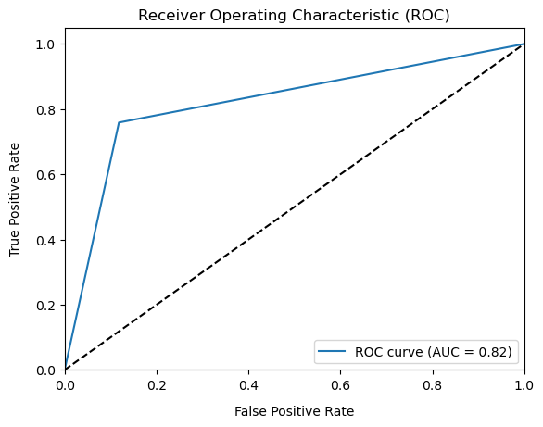
ML Algorithms
SVM
CLASSIFICATION REPORT
 | Non-ictal | Ictal | Macro/weighted avg
Accuracy | 81.76%
Precision | 0.78 | 0.87 | 0.83
Recall | 0.88 | 0.76 | 0.82
F1-Score | 0.83 | 0.81 | 0.82
Unable to process entire 20 lakh data points with SVM, so scaled the data to 20K datapoints.
Because in SVM algorithm it takes a O(n^2) computational space, so >10^5 it is difficult for it to process.

Slide 25
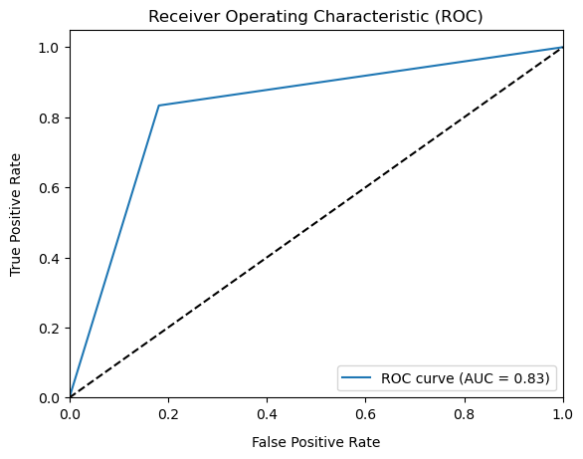
ML Algorithms
Random Forest
CLASSIFICATION REPORT
 | Non-ictal | Ictal | Macro/weighted avg
Accuracy | 90.90%
Precision | 0.83 | 0.82 | 0.83
Recall | 0.82 | 0.83 | 0.83
F1-Score | 0.82 | 0.83 | 0.83
Best of all experiments

Slide 26
Ensembled model - 1
Model | Accuracy | Precision | Recall | F1-Score
Random Forest | 0.81 | 0.80 | 0.80 | 0.83
SVM | 0.81 | 0.86 | 0.75 | 0.80
Logistic Regression | 0.49 | 0.49 | 1.00 | 0.66
XGBoost | 0.81 | 0.82 | 0.79 | 0.80
Ensemble | 0.82 | 0.83 | 0.80 | 0.81
Used Max voting ensembling technique – All model have equal weights in voting.

Slide 27
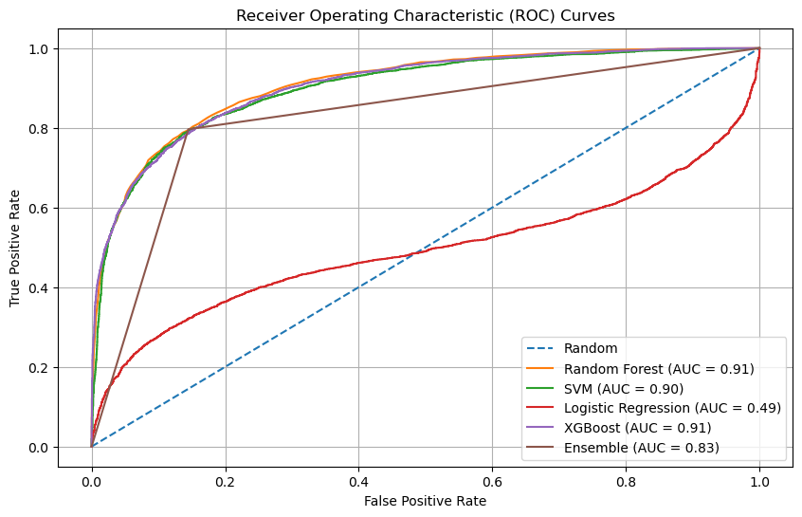
Ensembled model - 1
Notes:
Add ensemble

Slide 28
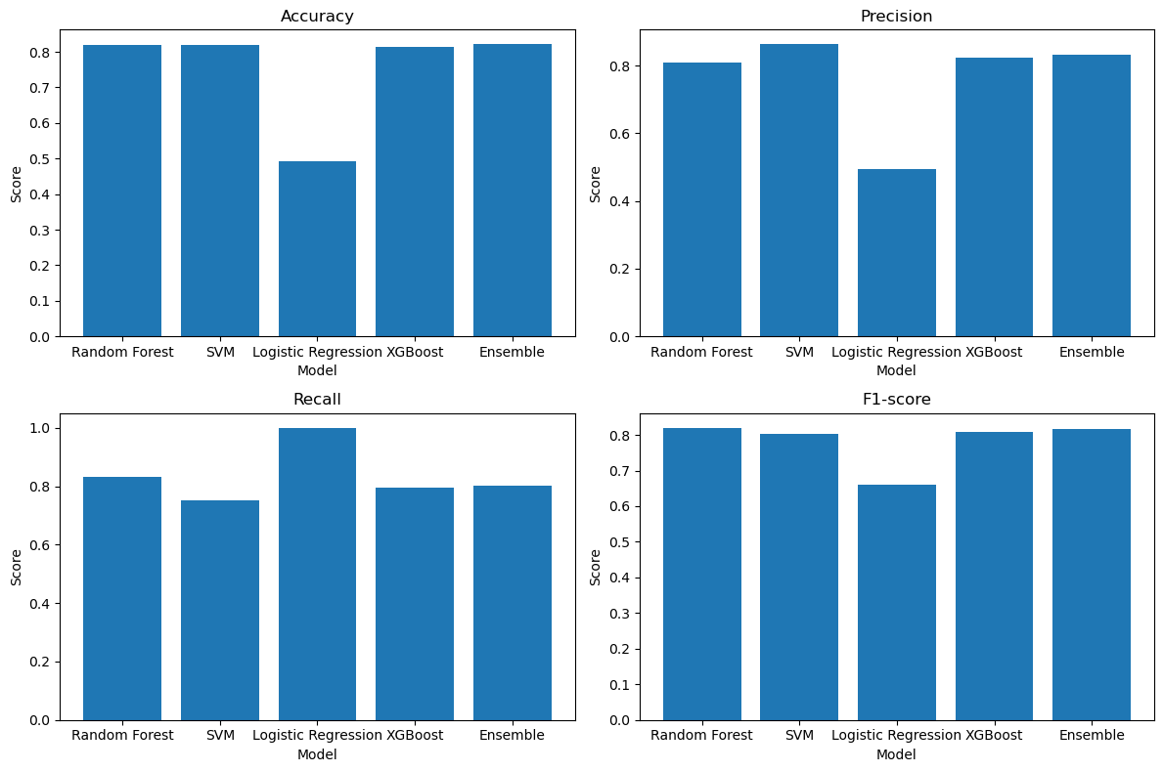
Ensembled model - 1
Notes:
Crop and keep apart

Slide 29
Ensembled model - 2
Model | Accuracy | Precision | Recall | F1-Score | Weights
Random Forest | 0.86 | 0.86 | 0.85 | 0.85 | 0.4
Logistic Regression | 0.49 | 0.49 | 1.00 | 0.66 | 0.1
Decision Tree | 0.77 | 0.77 | 0.77 | 0.77 | 0.2
XGBoost | 0.83 | 0.85 | 0.80 | 0.82 | 0.3
ENsemble | 0.85 | 0.86 | 0.83 | 0.84
Used soft voting ensembling technique, so weights are mentioned.

Slide 30
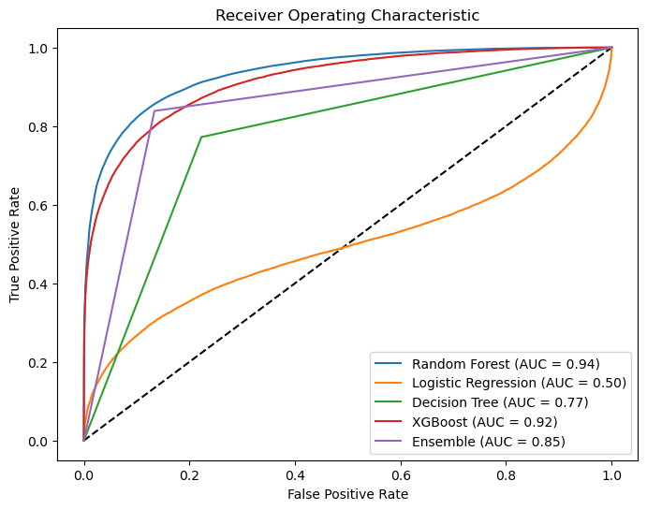
Ensembled model - 2

Slide 31
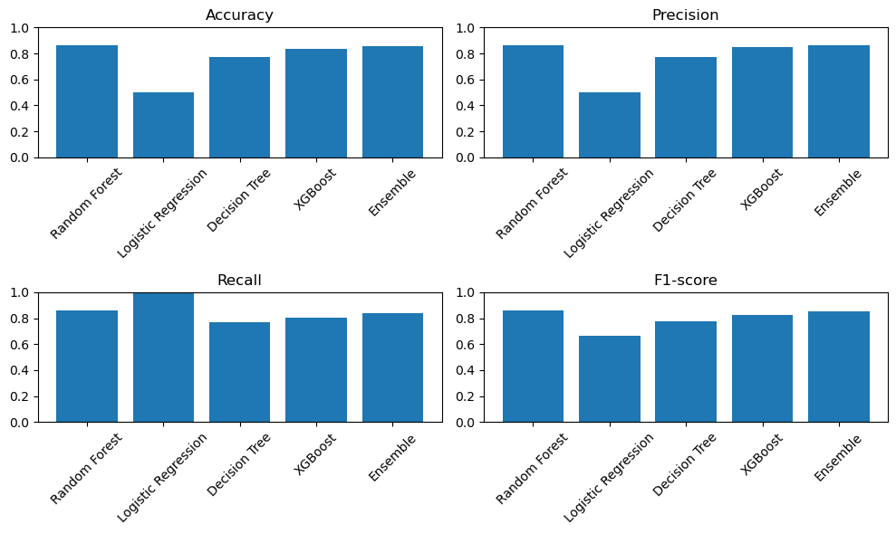
Ensembled model - 2

Slide 32
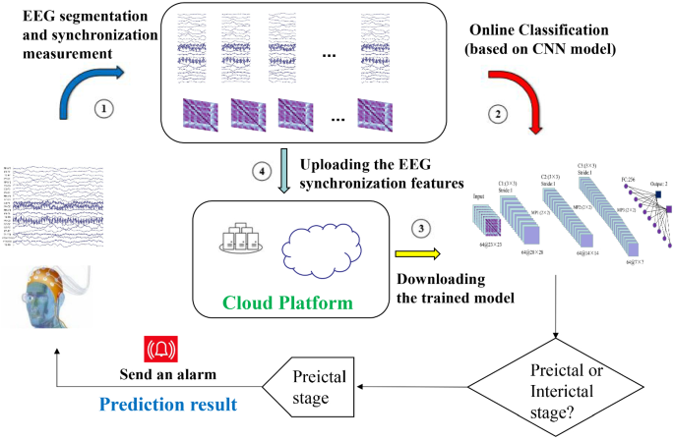
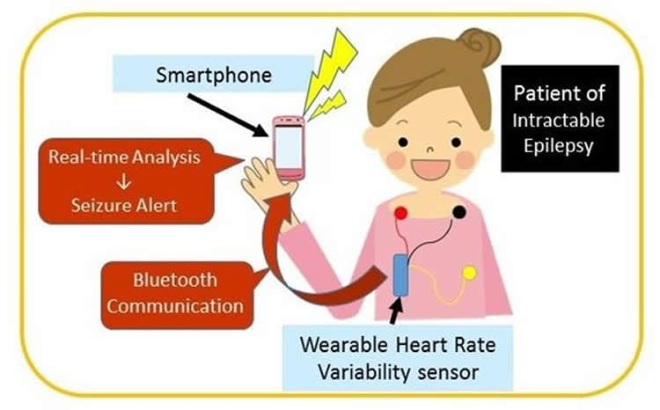
Way Forward, Impact, Outcomes Planned Ahead
Impact
If these seizure-permissive brain states can be identified, devices designed to warn patients of impeding seizures would be possible.
A timely and accurate prediction of seizures can prevent injuries during seizures
Forecasting signal and alerting if seizure detected
Using any standard sensor to get live data
Tool deployment
FINAL OUTCOME

Slide 33
Thank you

